Slide 1
Flow Visualization
Derived Quantities

Slide 2


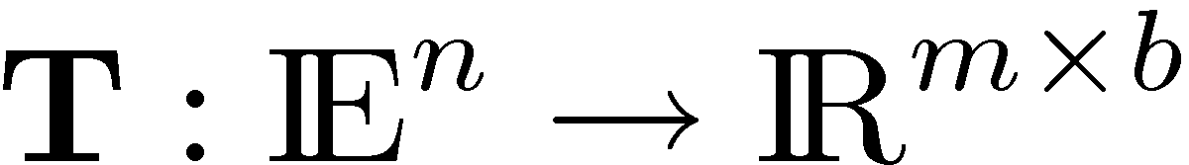
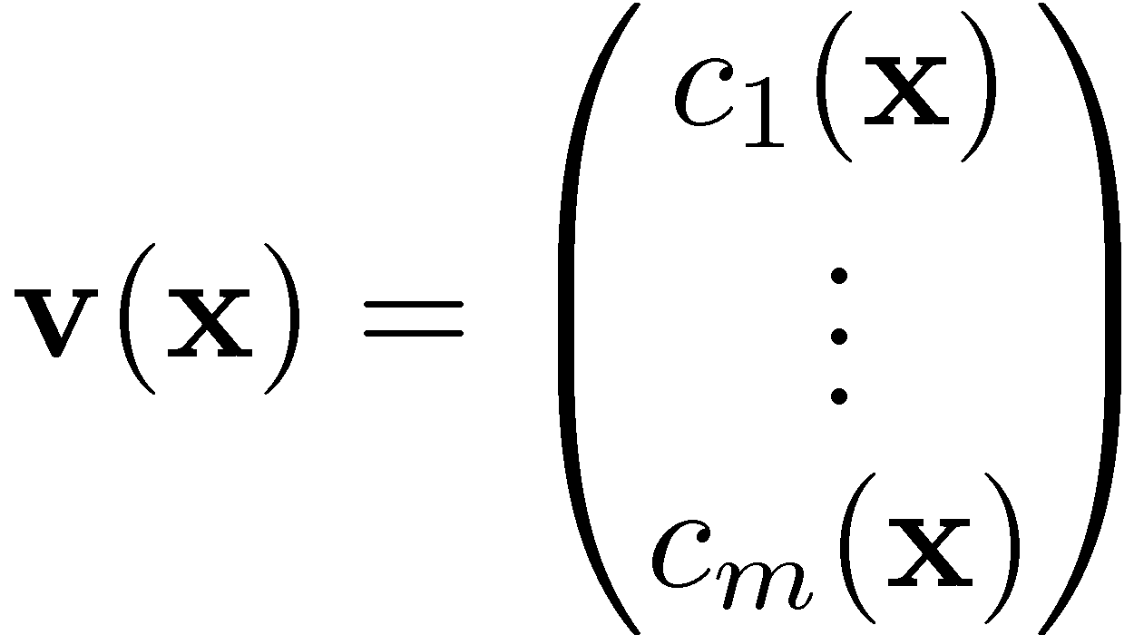
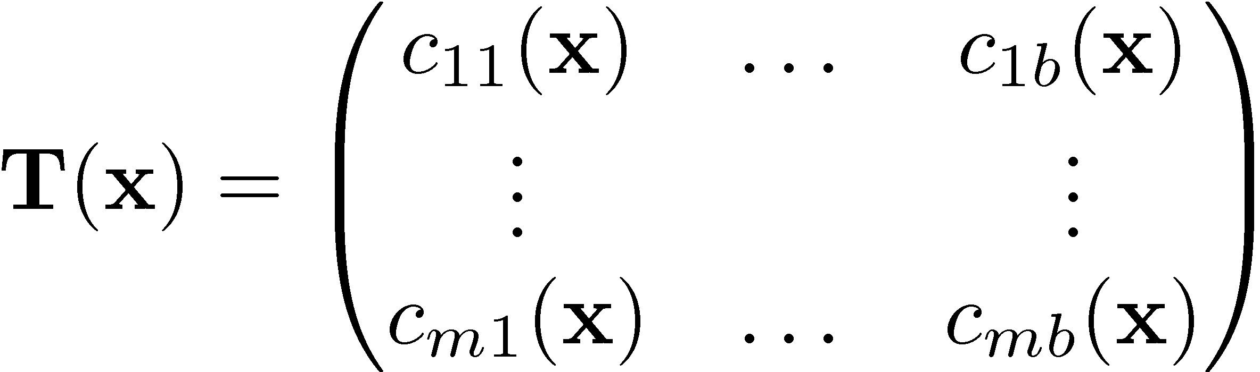
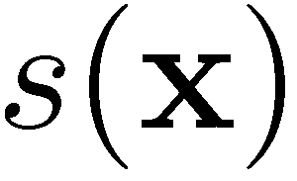

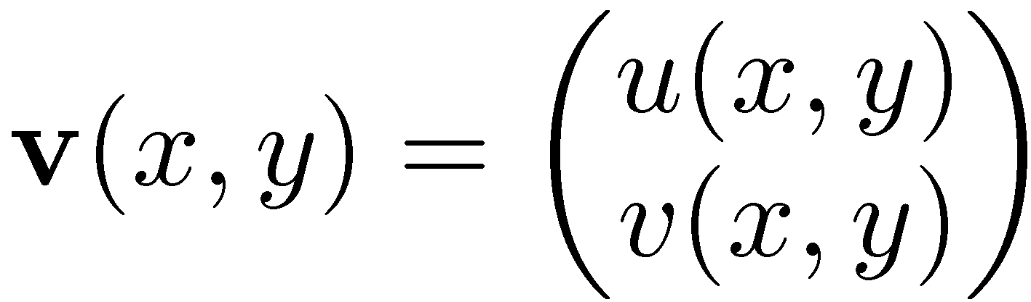
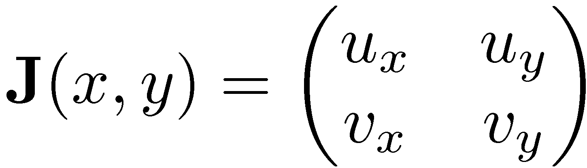
Flow Visualization: Problems and Concepts
scalar field
vector field
tensor field
2D vector field
Jacobian of 2D vector field

Slide 3
Flow Visualization: Problems and Concepts
vector field
tensor field
Supposed to be continuous and differentiable. This means we can compute its partial differentials and write them into the 2x2 matrix:
2D vector field
Jacobian of 2D vector field

Slide 4
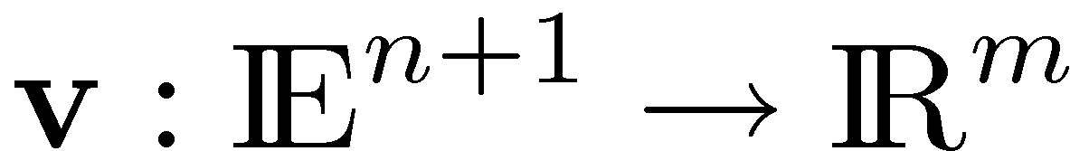
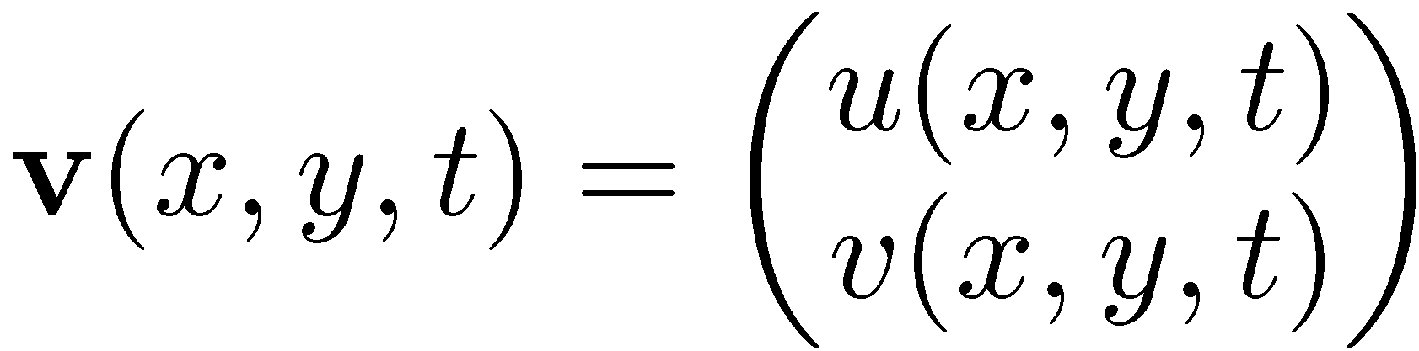
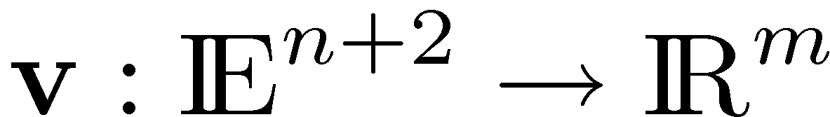
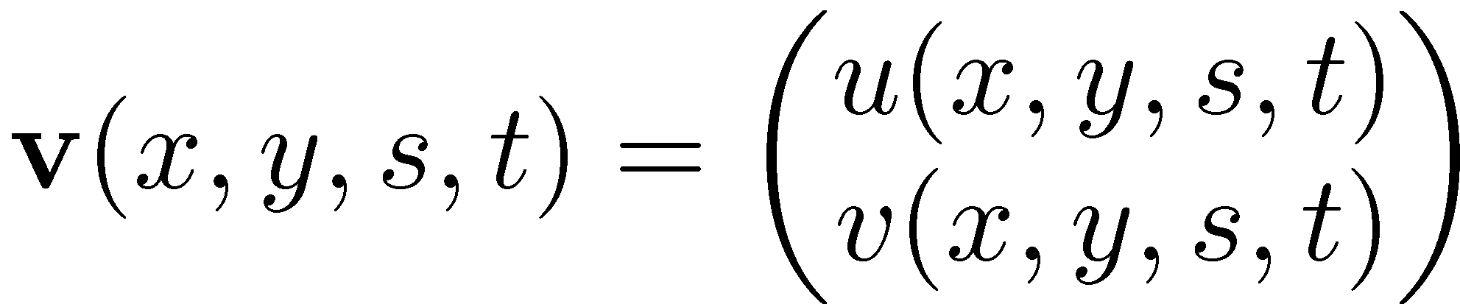
Flow Visualization: Problems and Concepts
vector field
parameter-independent
steady vector field
one-parameter-dependent
unsteady vector field
two-parameter-dependent

Slide 5
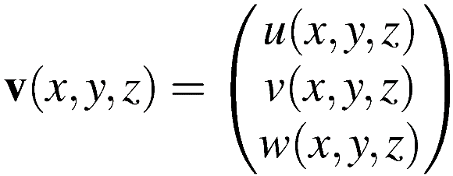
Flow Visualization: Problems and Concepts
Jacobian of a 3D vector field:
Consists of all first-order information of v
First-order partial derivatives of v
Jacobian of v

Slide 6
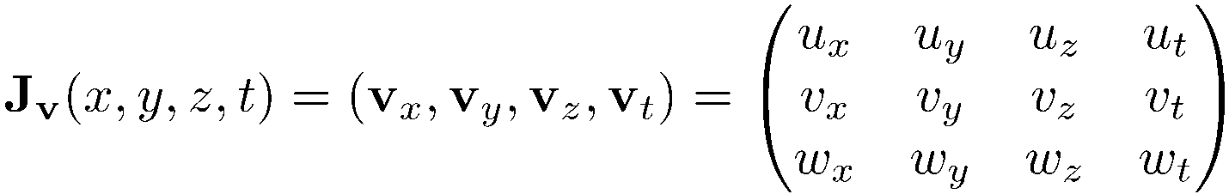
Flow Visualization: Problems and Concepts
Jacobian of an unsteady 3D vector field:

Slide 7
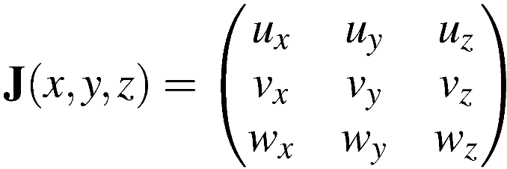
Overview
2D vector field
Jacobian of a 2D vector field
3D vector field
Jacobian of a 3D vector field

Slide 8
Flow Visualization: Problems and Concepts
Divergence of v:
scalar field
observe transport of a small ball around a point
expanding volume ➔ positive divergence
contracting volume ➔ negative divergence
constant volume ➔ zero divergence
div v ≡ 0 ⬄ v is incompressible
Notes:
8

Slide 9
Flow Visualization: Problems and Concepts
Curl of v:
vector field
also called rotation (rot) or vorticity
indication of how the field swirls at a point
9
Notes:
9

Slide 10
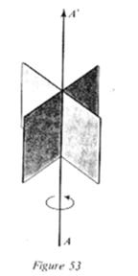
Flow Visualization: Problems and Concepts
Curl of v:
paddle wheel model:
insert paddle wheel in a flow
orient such that its rate of rotation is maximal
➔ curl v is parallel to main rotation axis
➔ |curl v| is corresponds to rate of rotation
golf ball model
consider golf ball in v
is transported and rotates
➔ curl v is parallel to main rotation axis
➔ |curl v| is corresponds to rate of rotation

Slide 11
Flow Visualization: Problems and Concepts
Properties of curl:
curl v ´ 0 ⬄ v is irrotational or curl-free
v = grad f ⬄ v is conservative
Conservative is subclass of curl-free, since curl grad f ´ 0 for any scalar field f

Slide 12
Flow Visualization: Problems and Concepts
Laplacian of a scalar field:
Scalar field
Divergence of the gradient of the scalar field

Slide 13
Flow Visualization: Problems and Concepts
Properties of the Laplacian of a scalar field:
L invariant under rotation and translation of the underlying coordinate system
L f ´ 0 ⬄ f is harmonic function
Interpretation of Laplacian:
Measure of the difference between the average value of f in the immediate neighborhood of the point and the precise value of the field at the point.

Slide 14
Flow Visualization: Problems and Concepts
The Nabla operator:
also called “Del”-operator
abbreviation: r
symbolically written as:

Slide 15
Flow Visualization: Problems and Concepts
The Nabla operator:
Allows us to write the other operators as:

Slide 16
Flow Visualization: Problems and Concepts
Scalar and vector identities:
for a constant c
at points x where
exam

Slide 17
Flow Visualization: Problems and Concepts
Scalar and vector identities (cont’d):
exam

Slide 18
Flow Visualization: Problems and Concepts
Decomposition of Jacobian Matrix:
J_{v} can be decomposed into symmetric and antisymmetric part:
with
symmetric part (shear contribution)
antisymmetric part (rotational contribution)
with

Slide 19
Flow Visualization: Problems and Concepts
Vortex-Strain duality:
Ω dominates S: high vortical activity
S dominates Ω: high strain

Slide 20
Flow Visualization: Problems and Concepts
¸₂ criterion:
Second largest eigenvalue of the symmetric tensor S² + Ω²
Vortices can be found where ¸₂ < 0
¸₂ > 0 lacks physical interpretation
Does not capture stretching and folding of fluid particles, i.e., does not describe the vortex-strain duality
Q-criterion, or, Okubo-Weiss parameter:
Q > 0: vortex region, since vorticity magnitude dominates the rate of strain
Q < 0: region of high stretching, since rate of strain dominates vorticity magnitude
Captures vortex-strain duality
Notes:
Lambda2 corresponds to local pressure minima in a plane -> equivalent to two positive eigenvalues of the pressure hessian -> two negative eigenvalues of S² + Ω^{2 −> ασ λ1 >= λ2 >=} λ3 ανδ αλλ ειγενϖαλυεσ αρε ρεαλ−> λ2 < 0
Σεε [Ον τηε ιδεντιφιχατιον οφ α ϖορτεξ, ϑινηεε ϑεονγ, Φαζλε Ηυσσαιν, 1995]

Slide 21
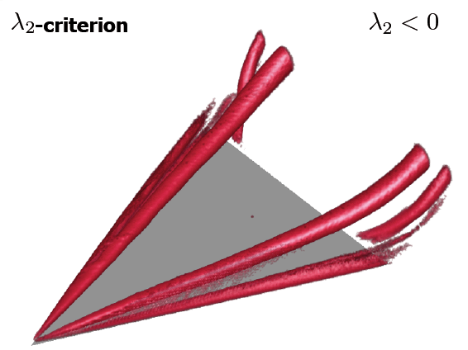
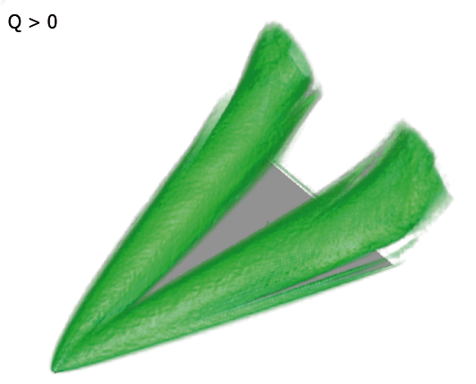
Flow Visualization: Problems and Concepts

Slide 22
Visualization and Data Analysis
Feature-based Methods I

Slide 23
Feature-based Methods I: Content
Introduction to feature-based data analysis and visualization
What is a feature?
Difference between classic visualization and feature-based visualization
Examples for features
Extremal Structures I
What are extremal structures?
Applications
Ridges and Valleys (Height Ridges)
General definitions following Eberly and Lindeberg
Ridges/Valleys in 2D (lines)
Ridges/Valleys in 3D (lines and surfaces)
Tool for extracting ridges/valleys in 2D: marching squares (isolines)

Slide 24


Slide 25
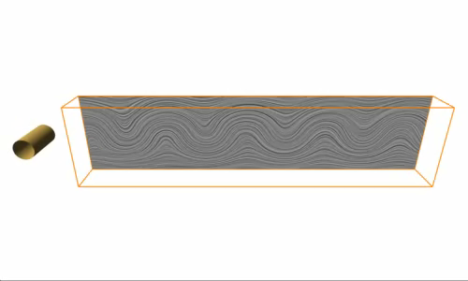
Flow behind a cylinder. Data courtesy of Bernd R. Noack (TU Berlin).
Feature
n-dimensional geometrical structure embedded into m-dim. Domain
yields certain „insight“
definition depends on application

Slide 26
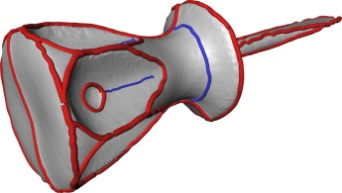
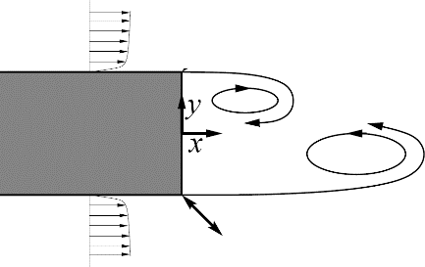
Data
Analysis
Benefit
01010101001110100101010101010110
01010101001110100101010101010110
automated
target-oriented
objective
01010101001110100101010101010110
Shape descriptors
Large data sets,
multi-run simulations,
parameter space,
3D scanners
Conceptual flow models
Feature-Based Data Analysis
reduction of information
interactive visualization
faster analysis

Slide 27
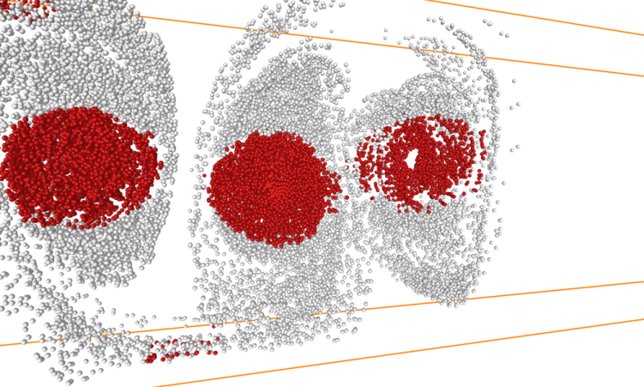
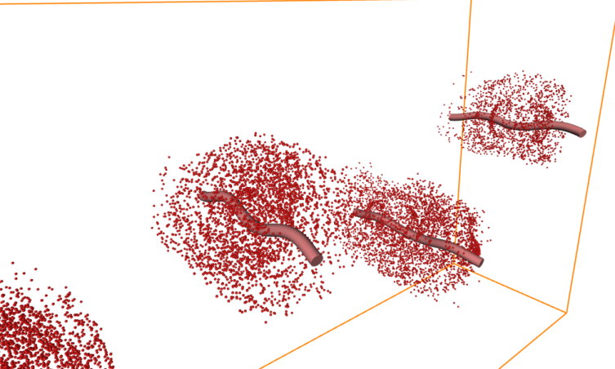
Classic vs. Feature-based Visualization
very important
Classic Visualization
Feature-based Visualization
Showing a feature
Human understands what the feature is
Path? – Velocity? – Life time? – Interdependency? – Importance?
➔ Qualitative analysis
Having a feature and showing it
Human and Computer understand what the feature is
Path! – Velocity! – Life time! – Interdependency! – Importance!
➔ Quantitative analysis (e.g. statistics)
➔ Qualitative analysis

Slide 28
Classic vs. Feature-based Visualization
very important
Classic Visualization
Feature-based Visualization
– Requires subjective interpretation of the image to find the most interesting parts of a data set
+ Low cognitive load
“Easy to understand what is shown”
+ Employs objective mathematical definitions to extract the most interesting parts of a data set
– Medium to high cognitive load
“Difficult to understand what is shown”
Disclaimer: These are general remarks, which apply to most classic/feature-based methods, but not to all. It depends on the specific method and the application.

Slide 29
Classic vs. Feature-based Visualization
very important
Classic Visualization
Feature-based Visualization
– Requires subjective interpretation of the image to find the most interesting parts of a data set
– Cannot be automated in a reasonable way. Therefore, difficult to use with very large data sets.
+ Employs objective mathematical definitions to extract the most interesting parts of a data set
+ Can be automated to run on a supercomputer (for example together with the simulation).
Disclaimer: These are general remarks, which apply to most classic/feature-based methods, but not to all. It depends on the specific method and the application.

Slide 30
Classic vs. Feature-based Visualization
very important
Classic Visualization
Feature-based Visualization
No automation and direct rendering of original data:
+ No pre-computation
– User needs more time for analysis
Automation and interactive rendering of the feature set:
– Pre-computation (feature extraction)
+ User needs less time for analysis
Disclaimer: These are general remarks, which apply to most classic/feature-based methods, but not to all. It depends on the specific method and the application.

Slide 31
Classic vs. Feature-based Visualization
very important
Classic Visualization
Feature-based Visualization
– No data reduction. Usually, all is shown.
Rendering can be slow or fast; depends on the method and the size of the data
+ Data reduction. Only a small set of geometric objects is shown.
+ Fast, interactive rendering
Disclaimer: These are general remarks, which apply to most classic/feature-based methods, but not to all. It depends on the specific method and the application.

Slide 32
Classic vs. Feature-based Visualization
very important
Classic Visualization
Feature-based Visualization
– No data reduction. Usually, all is shown.
– Experts need to dig through all the data.
+ Non-experts have the context they need for understanding.
+ Data reduction. Only specific aspects are shown.
+ Experts can concentrate on the most important parts.
– Non-experts need additional context to understand.
Disclaimer: These are general remarks, which apply to most classic/feature-based methods, but not to all. It depends on the specific method and the application.

Slide 33
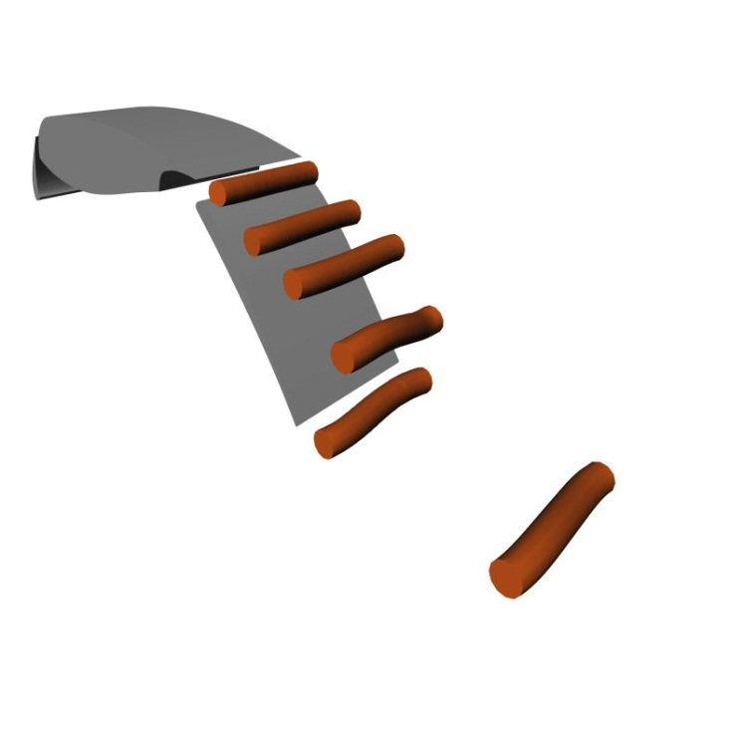
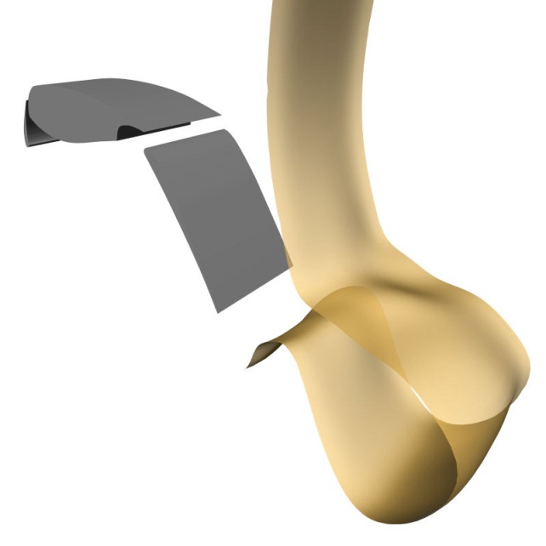
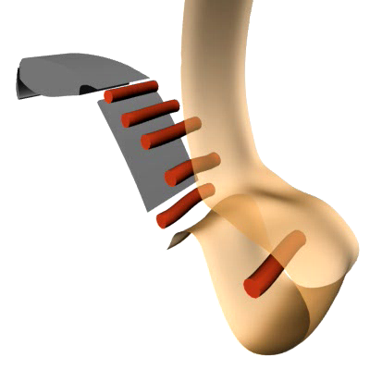
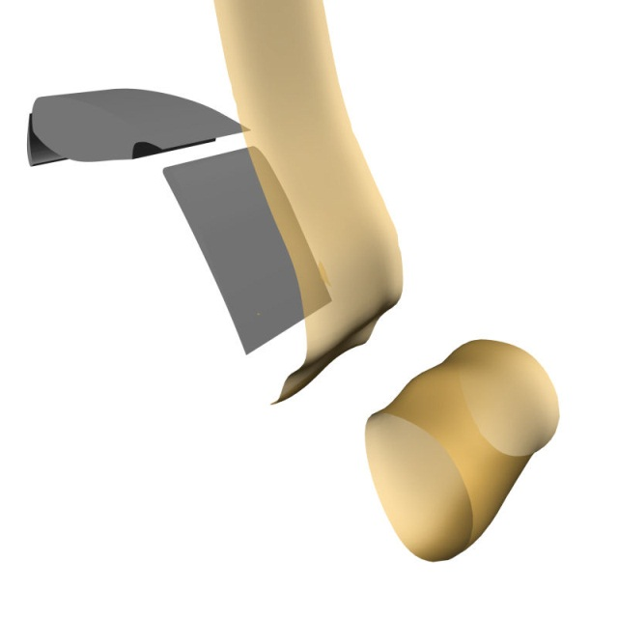
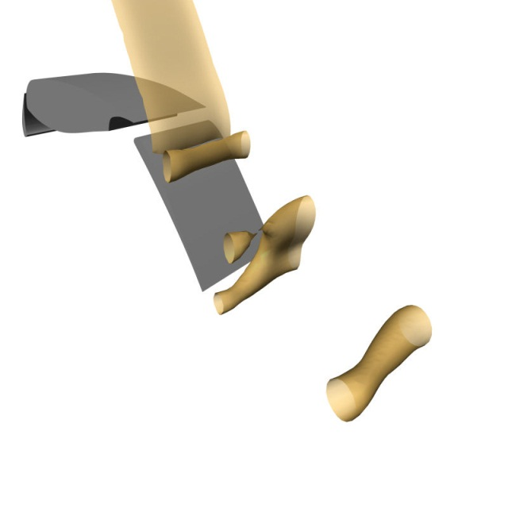
Classic vs. Feature-based Visualization
Classic Visualization
Feature-based Visualization
Isosurface p = -0.1
Isosurface p = -0.18
Isosurface p = -0.28
This is tedious, repetitive work!
Did I miss something?
Expert
Done. Thanks.
Yes, I get the basic idea.
Non-Expert
What is this?

Slide 34
Feature-based Visualization
very important
Feature Extraction
Features:
Represent interesting structures or objects in the data
Extract and visualize them
The original (large) field is not needed anymore for visualization
Extraction can (usually) be automated
Rendering is fast and (usually) interactive
Medium to high cognitive load
Typical features:
Topological features
Vortices
Shock waves
Extremal structures

Slide 35
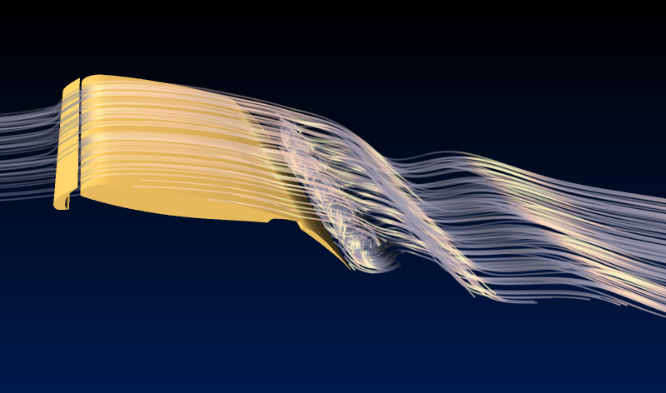
Example of a feature-based analysis and visualization
DFG Collaborate Research Center
“Control of Complex Turbulent Shear Flows” (SFB 557)
2004 – 2007, 2007 – 2010
18 research projects, 6 research transfer projects
Flow around an airfoil. Data courtesy of Bert Günther (TU Berlin).

Slide 36
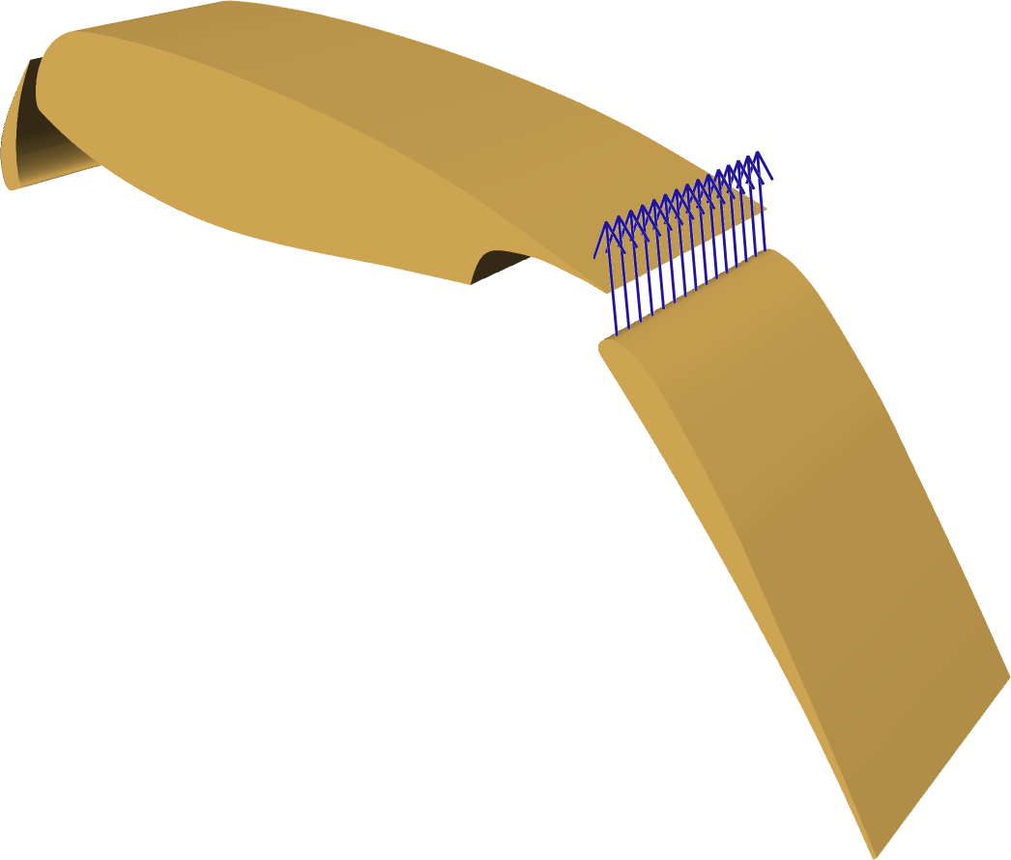
Excitation by periodic blowing and suction at the rear flap
Parameters:
Frequency of air injection
6 dimensional data set
23 parameter variations
3D flows with 200 time steps
1.3 million cells
200 GB data
Intensity of air injection

Slide 37
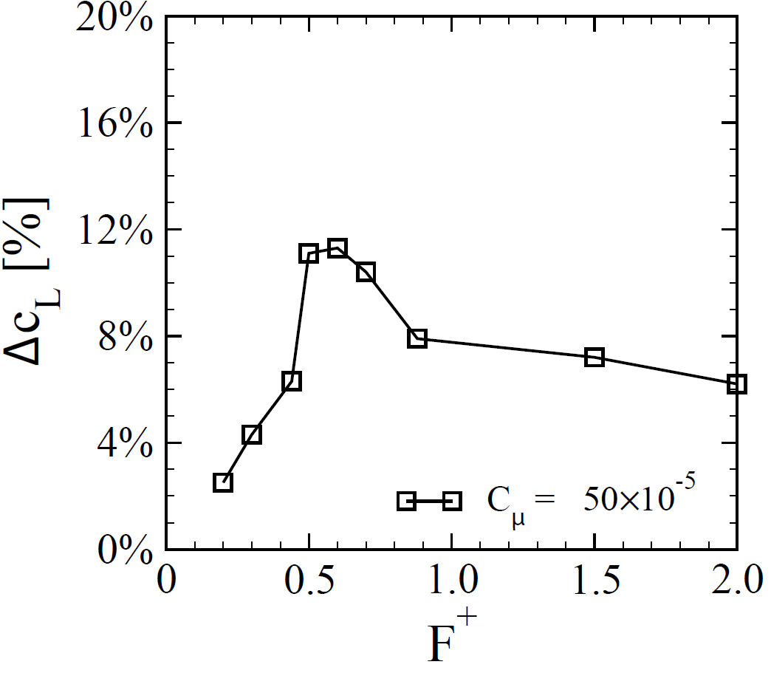

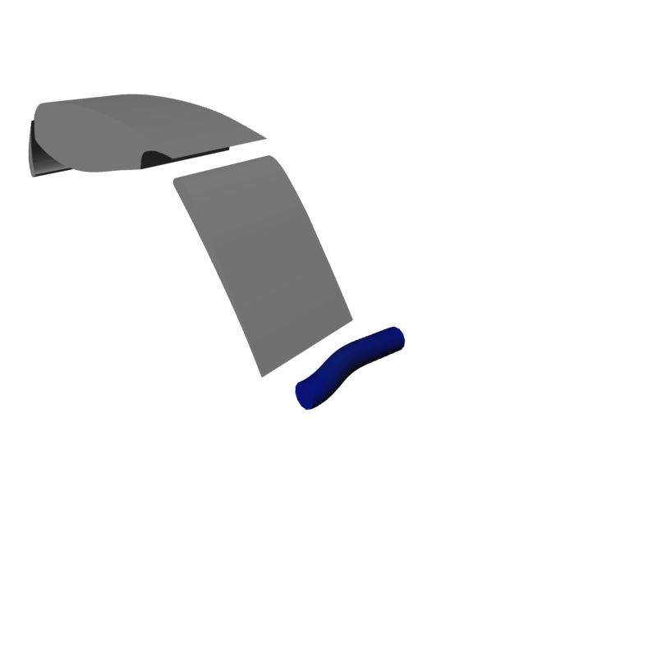
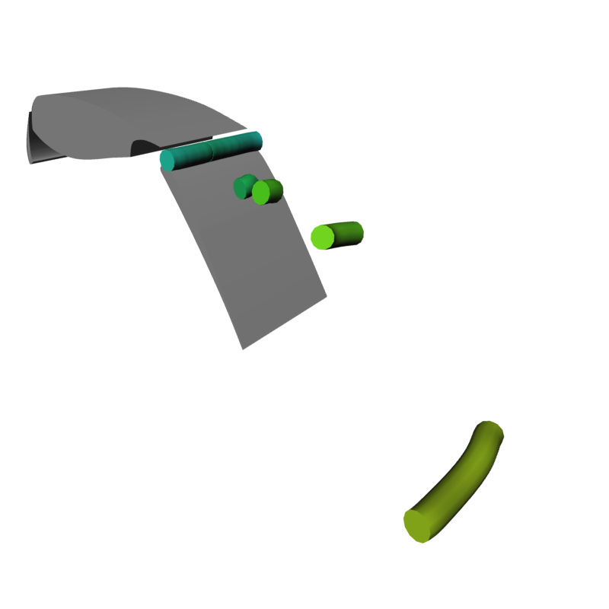
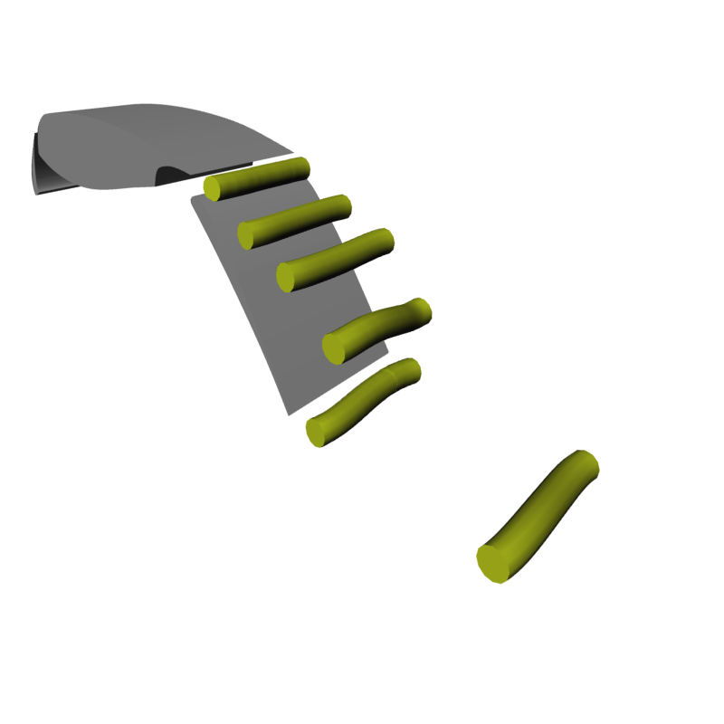
Flow around an airfoil. Data courtesy of Bert Günther (TU Berlin).
Frequency
low
Pressure
high
strong
Vortex
weak
unexcited flow
F = 0.6
Lift: + 11.2%
F = 2.0
Lift: + 6.1%

Slide 38
Local vs. Global Features
very important
Local Features
Global Features
For every point: decision by local analysis if it belongs to the feature
Obtained by global analysis
y=f(x)
global / local
local
local
local
local
local
local
local
local
x
maximum
minimum
root (zero crossing)
local
global / local

Slide 39
Local vs. Global
very important
Local or global: Isosurface?
Local: We can decide for every point x in our domain if f(x) = iso by just looking at the point and its function value f(x).
Local or global: Stream line?
Global: We cannot locally decide whether a point is part of a stream line. We need to integrate the stream line (possibly indefinitely) to find out if it hits a certain point.
Local or global: Arithmetic mean of some numbers?
Global: We cannot decide for any given number if it is the arithmetic mean by just considering this number. We need to run over the whole array of numbers and compute the arithmetic mean by considering all numbers in the array.

Slide 40
Local vs. Global Features
very important
Local Features
Global Features
(Local) minima and maxima
Roots (zero crossings)
Ridge and valley lines/surfaces
Cores of swirling motion
Critical points
Boundary switch points/curves
Fold, Hopf bifurcations
Global minimum and maximum
Separatrices
Closed stream lines
Saddle connectors
Boundary switch connectors
Topological segmentation (aka topological skeleton or Morse-Smale complex)
Saddle connections (hetero-/homoclinic orbits)
Watersheds / watercourses

Slide 41
Extremal Structures
Introduction

Slide 42
Extremal structures of a 1D function
y=f(x)
x
maximum
minimum
The extremal structures of a 1D function are:
minima and maxima
(often also called extrema)

Slide 43
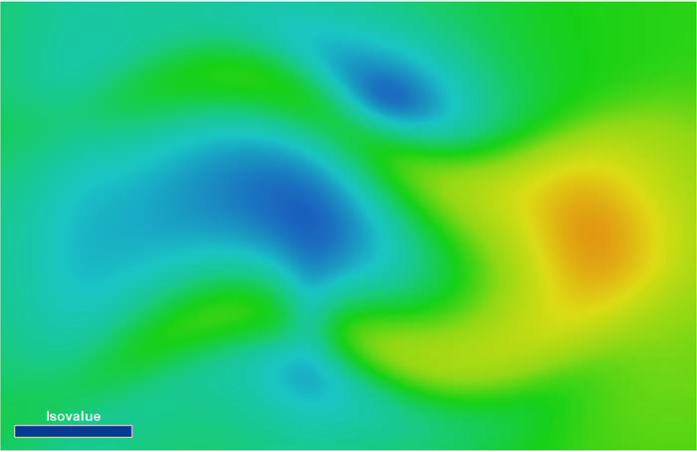
Extremal structures of a 2D scalar field

Slide 44
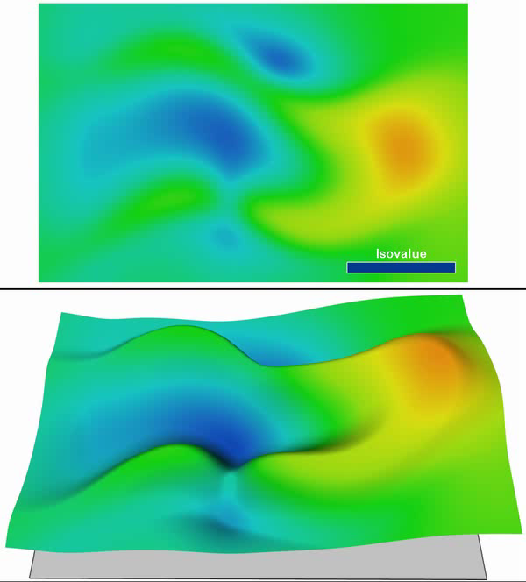
Extremal structures of a 2D scalar field

Slide 45
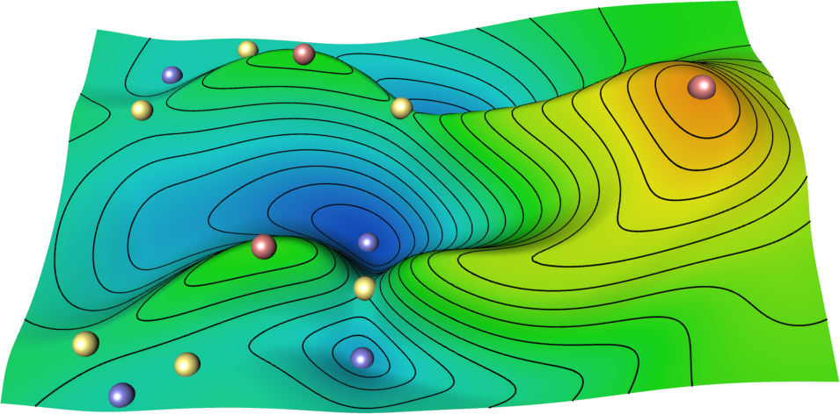
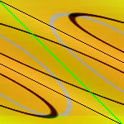

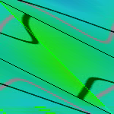
Extremal structures of a 2D scalar field
maximum
minimum
saddle

Slide 46
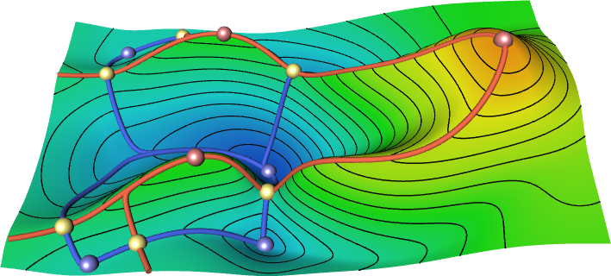
Extremal structures of a 2D scalar field
The extremal structures of a 2D scalar field are:
minima and maxima points (extrema)
minimal and maximal lines (extremal lines)

Slide 47
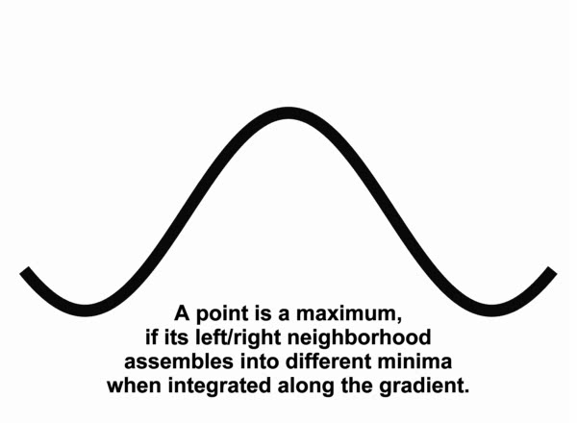
Intuition behind extremal lines

Slide 48
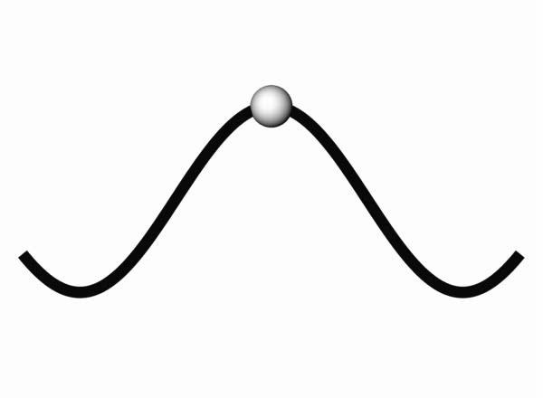
Intuition behind extremal lines

Slide 49
Extremal structures of a 3D scalar field
The extremal structures of a 3D scalar field are:
minima and maxima points (extrema)
minimal and maximal lines (extremal lines)
extremal surfaces: surfaces of minimal/maximal scalar data value
Please, do not say “minimal surface”. That is something different.

Slide 50
Definitions of extremal structures
Ridges / Valleys
local features
Watersheds
global features
Topological separatrices
global features
Watersheds and topological separatrices are closely related.

Slide 51
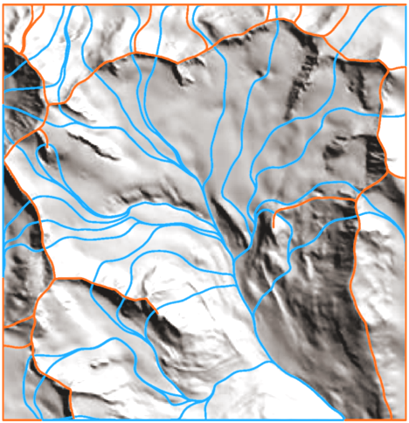
Applications of extremal structures
Geomorphology
Computer vision
Computer graphics
Scientific visualization:
Scalar field visualization
Flow visualization
DT MRI visualization
etc.
Image: Steger 1999

Slide 52
Extraction of Salient Edges on Surfaces
T. Weinkauf, D. Günther
Separatrix Persistence: Extraction of Salient Edges on Surfaces Using Topological Methods
Computer Graphics Forum (Proc. SGP '09) 28(5), July 2009

Slide 53
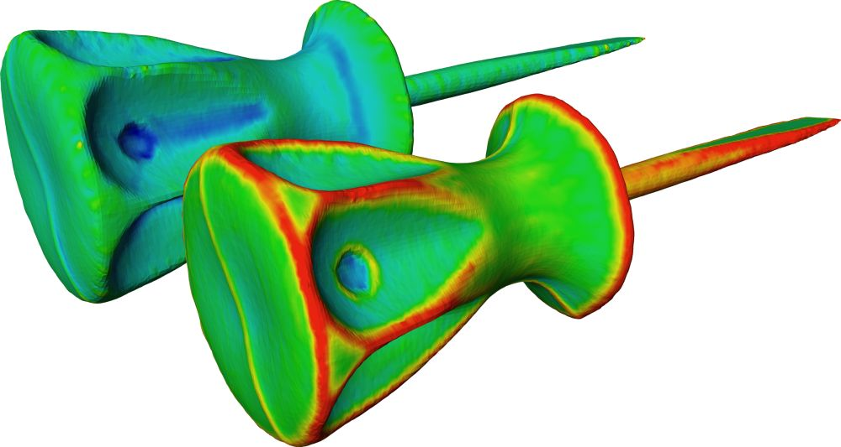
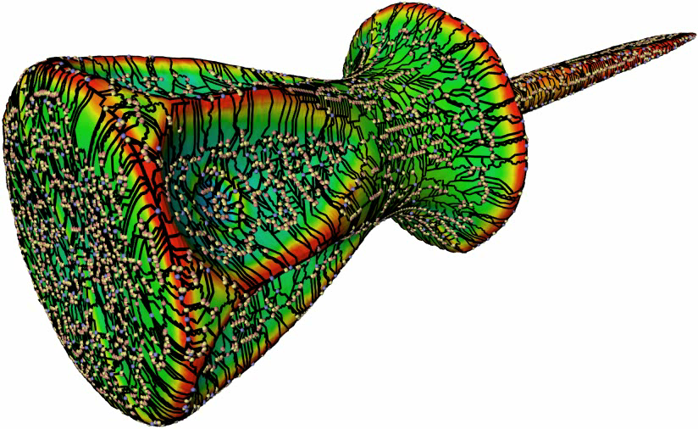
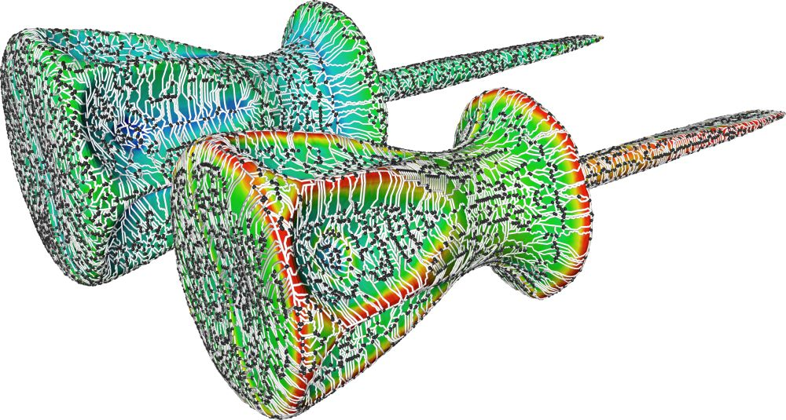

Salient Edges
Principal curvatures
Persistence:
significance of critical points
Topological skeletons
of the principal curvatures
Separatrix persistence:
significance of each point
of a separatrix

Slide 54
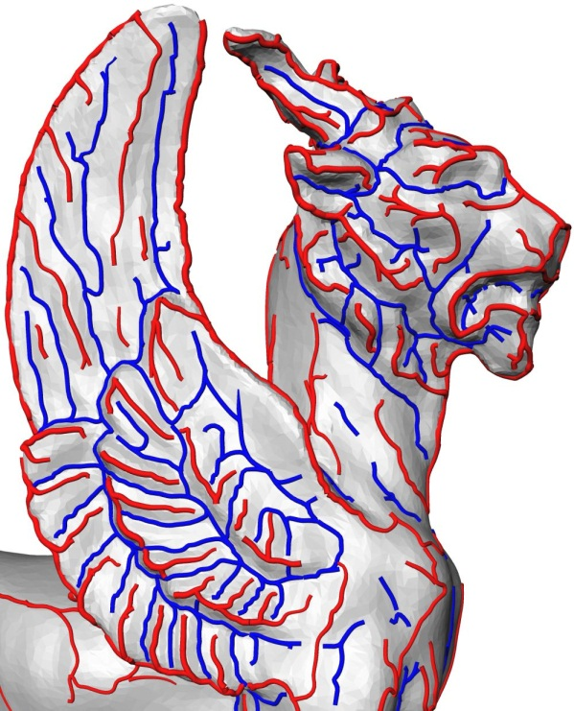
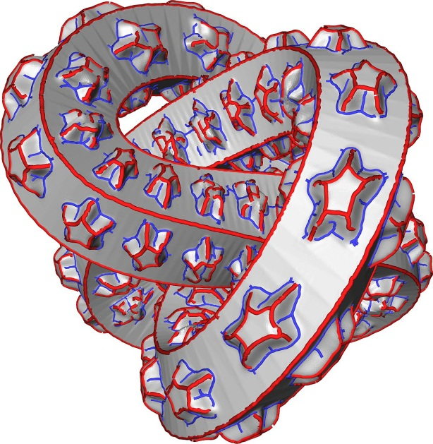
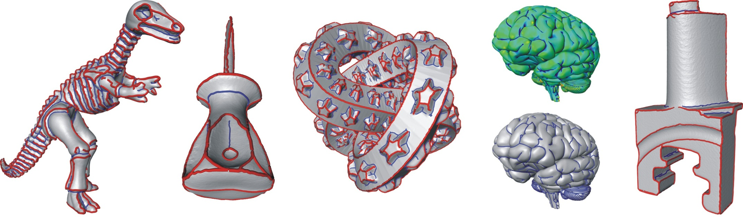
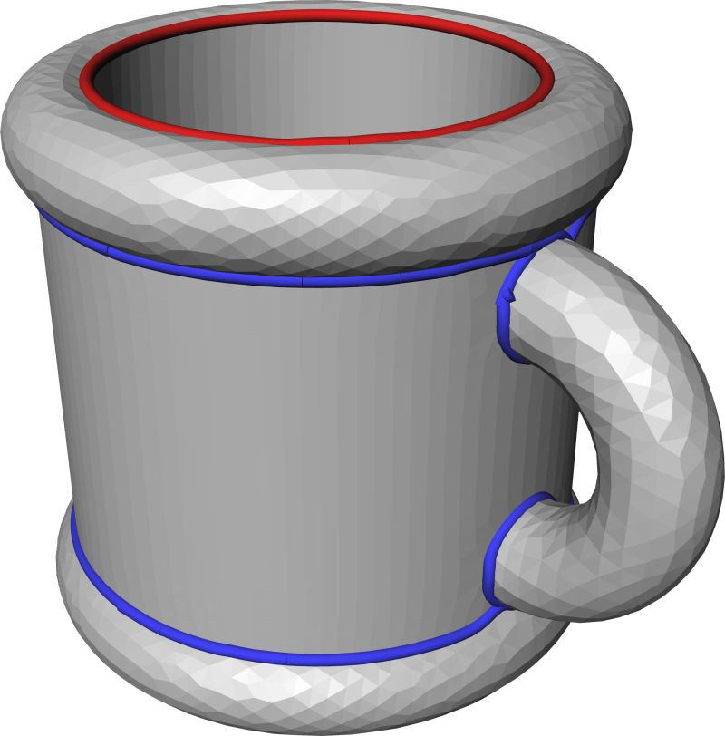
Salient Edges
Examples

Slide 55
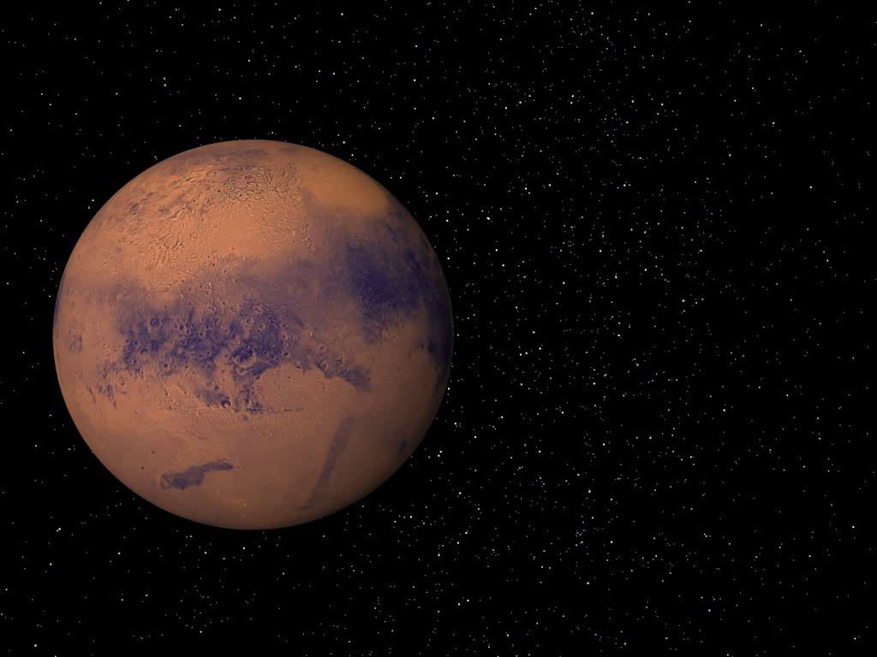
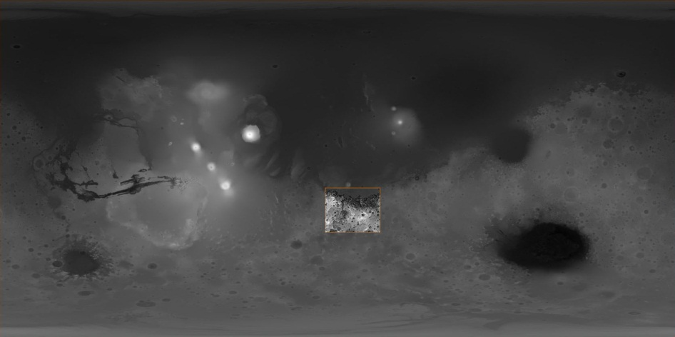
Rivers on Mars
NASA Mars Global Surveyor
Launch: November 7, 1996
Mission: Mapping of Mars
Time: 4.5 years
Mars Orbiter Laser Altimeter
Determines the height of surface features on Mars
640 million elevation measurements
Global grid with 200m at equator; less elsewhere
Accuracy: 2-13m
Mars Orbiter Laser Altimeter
Determines the height of surface features on Mars

Slide 56


Objective: Extract river networks on Mars (lines of minimal surface height)
Manual mapping of networks
[Carr, J. Geophy. Research, 1995]
Valleys based on derivatives
& manual curation
[Hynek et al., Geology, 2003]

Slide 57



Objective: Extract river networks on Mars (lines of minimal surface height)
Günther, Weinkauf (MPII Saarbrücken), Patrick McGuire (U Chicago) and Sebastian Walter (FU Berlin)
Extract topology and filter lines using separatrix persistence
Different levels of detail

